Slide 1




Slide 2

RESUME SKILLS -1

Slide 3
RESUME SKILLS
How resume template helps ?
Organize Your Resume
No Experience Needed
Make a Great First Impression
Save Time
Notes:
Read on for some of the most interesting benefits you should consider when deciding whether to use a resume template.
1. Organize Your Resume : It is very important that your resume is organized and filled out appropriately. A well-organized resume looks more professional than one that is not organized. Using a resume template helps you organize your thoughts and ensures that everything is filled in its appropriate place. It helps you remember important details that should be on your resume, making sure that nothing important is left out.
2. No Experience Needed : You don’t need any experience to create your resume using a resume template. Templates are always very easy to fill out and if you are not satisfied with the arrangement, you can modify it to best suit your individual needs as the job-seeker. A lot of people don’t have a clue about how to start typing or building a resume from scratch. If you’re anything like me and you are one of those people, you can keep things simple by using a resume template and be assured that you have correctly filled in every critical detail you require for the job application.
3. Make a Great First Impression : Your resume is the first understanding and impression that an employer gets of you.2 It sets out your skills, talent level(s), experience, and all the other information an employer would need to know in order to understand your potential as a candidate for the job in question. If your resume is not properly written or constructed, you might not even be considered or given a chance to prove yourself. Using a creative resume template would help you adequately showcase your skills and talents to an employer.
4. Save Time : Designing and building your own resume from scratch can be time-consuming and after spending lots of time and energy on it, you might not end up with a good result, especially if you are not familiar with great resume building. Using creative resume templates would be a good way to save your time and show your potential employers that you have the necessary skills for the job. Using resume templates is also a time-saving advantage if you are applying for more than one job. Creating different types of resumes for the jobs you are applying for could take a lot of time because not every job requires the same resume format because you might need different skills for different jobs and clients. With a resume template, you can easily modify the template and create several versions of your resume that suit other job industry standards if you are applying for several jobs at the same time. That way you would have the appropriate resume format for each desired position or job that you are applying for. From saving time to making a great first impression, there are lots of advantages and benefits of using a template and these are just a few of them. There are also several template building websites and applications that you can use to achieve this.

Slide 4

RESUME SKILLS
Resume format importance
Notes:
The format of your resume is just as important as the information you put in it. Resume formats can determine the way a recruiter or hiring manager perceives you, and more importantly how the ATS parses each section included in your resume. Your resume format is the first quick impression of you both personally and professionally.
Formats are also important in capturing the recruiter or hiring manager’s attention. They most likely only have time to skim your resume, so your goal is to put the most important information about yourself in places that are easily seen (aka at the top). Don’t hide accomplishments and relevant experience too deep within your resume.
Different resume formats highlight different aspects of your professional skills and accomplishments. Once you get an interview, you can go into more detail about yourself, but your resume should showcase the very best things. So, choosing the correct format, based on your professional history, can make a big impact on recruiters very quickly.

Slide 5
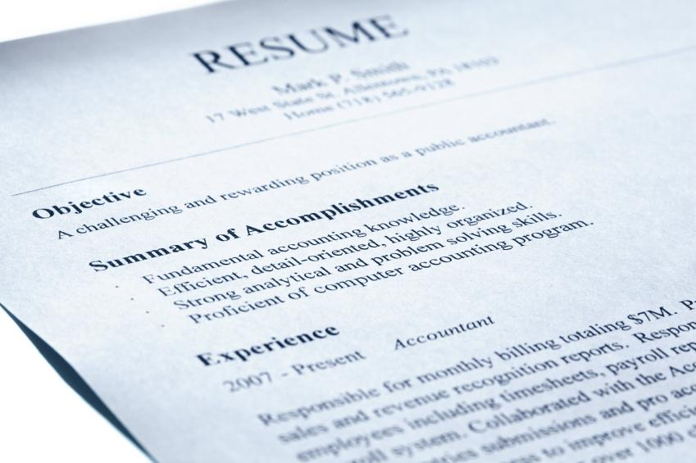
RESUME SKILLS
Formatting - Use of color and font
Notes:
The format of your resume is just as important as the information you put in it. Resume formats can determine the way a recruiter or hiring manager perceives you, and more importantly how the ATS parses each section included in your resume. Your resume format is the first quick impression of you both personally and professionally.
Formats are also important in capturing the recruiter or hiring manager’s attention. They most likely only have time to skim your resume, so your goal is to put the most important information about yourself in places that are easily seen (aka at the top). Don’t hide accomplishments and relevant experience too deep within your resume.
Different resume formats highlight different aspects of your professional skills and accomplishments. Once you get an interview, you can go into more detail about yourself, but your resume should showcase the very best things. So, choosing the correct format, based on your professional history, can make a big impact on recruiters very quickly.

Slide 6

RESUME SKILLS
Structure of a standard resume
Notes:
This is the template for slides with only an image

Slide 7

RESUME SKILLS
Tips
Notes:
Resume templates are a quick and easy way to start on your resume. A template includes the basic format of a resume. All you have to do is simply edit the document to include your personal information. Using a template can reduce the amount of time you have to spend formatting, allowing you to focus on ensuring that the content of your resume shines.
NOTE: “ATS stands for Applicant Tracking Systems” An ATS is a type of software application that handles the recruitment process, namely sorting through thousands of resumes, to determine which ones are the best fit for the positions for which they were submitted. Applicant tracking systems do not process your resume so differently from recruiters glancing at your resume, as both are looking for certain criteria for inclusion. Whereas human recruiters are often looking for grounds for automatic rejection, such as spelling errors or lack of relevant skills, applicant tracking systems operate by searching resumes for keywords. Few reasons for the usage of ATS by recruiters are to keep a track of candidates, to keep tabs on the list of resumes obtained, and to avoid accidents like missing resumes or deleting mails with resume The ATS rank the resume of a candidate by checking If more number of keywords matches rank increases Now that you are clear about the structure of resumes let’s focus on formatting to get the best resume done.

Slide 8
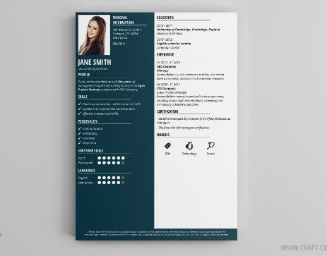
RESUME SKILLS
Use of colour in a resume
Notes:
Most resumes use a standard black and white format. There is a reason for this bright colours are distracting and take away from your actual content. With that said, you can use some colour if you want, just make sure it complements your content rather than detracts from it. Your name, as well as the headers throughout your resume can be modified– but make sure you use the same colour here to keep things uniform. A dark red, blue or green can be a nice touch.

Slide 9
RESUME SKILLS
Use of font :
Serif
Times New Roman
Garamond
Georgia
Sans-serif
Arial
Calibri
Verdana
Notes:
Best font for a resume: Creating a clear, succinct resume requires multiple elements working in harmony. For this to happen, one thing is certain: don’t use Comic Sans. Choosing an aesthetic font might seem daunting, but it doesn’t need to be.
There are two key groups of fonts used globally: serif and sans-serif (i.e. “non- serif”).
Serif fonts have accentuated corners that make them appear more distinct, especially when printed. Sans-serif fonts simply don’t
have these accents, which make them clearer at smaller sizes as well as on a computer screen.
Here’s a breakdown of our top three serif and sans-serif options:
Top 3 serif choices:
1. Times New Roman: Times New Roman is a classic serif that looks good both on paper and on a computer screen. It’s a safe, standard choice for any resume.
2. Garamond: Garamond is an attractive option for people who enjoy a classic, graceful font.
3. Georgia: Georgia is also a popular choice. Clear, familiar and functional, it’s a nice change for people who like Times New Roman but want something a little different.
Top 3 sans-serif choices:
1. Arial: An excellent choice if you prefer the sans-serif style. It is easy to read, and familiar to many people due to its appearance on commonly used web applications like Gmail.
2. Calibri: Popular amongst professionals. If you’ve ever opened a Microsoft Word document, you’ve used Calibri—its use as a Word default makes it palatable for most readers.
3. Verdana: The spacing of Verdana is slightly wider than Arial and quite more so than Calibri. Choose this style if you’re aiming for ease-of-reading.

Slide 10

RESUME SKILLS
Introduction to Power verbs and Write up
Notes:
This is the template for slides with only an image

Slide 11

RESUME SKILLS
What is Power verbs ?
Notes:
Power verbs are action words that have positive meanings in English. When you use a power verb, you can communicate your message more strongly and confidently than when using other verbs. Developed is a power verb. You sound more confident and interesting using 'developed'

Slide 12
RESUME SKILLS
Power verbs example :
Planning
Organizing
Executing
Supervising
Notes:
• Planning:
Example: Developed and implemented a training program that resulted in a 45% increase in employee satisfaction
Administered Commissioned Developed
Observed Prepared Researched
Anticipated Determined Devised
Planned Prioritized Reserved
Strategized Evaluated Forecasted
• Organizing:
Example: Coordinated weekly office schedules for 8 employees
Acquired Appointed Collected
Ordered Retrieved Simplified
Issued Facilitated Catalogued
• Executing:
Example: Handled 20-35+ customer calls per shift regarding coverage changes, renewal rates and billing procedures
Acted Collected Displayed
Merchandised Proved Sold
Exercised Forwarded Input
• Supervising:
Example: Developed and supervised the implementation of new computer filing system that reduce paper use by 35%
Adjusted Certified Correlated
Measured Overhauled Refined
Supplied Examined Screened

Slide 13
RESUME SKILLS
Power verbs example :
Leading
Balanced
Communicating
Notes:
• Leading:
Example: Trained 20+ new employees in computer procedures over a 2-year period
Accelerated Changed Elected
Inspired Mentored Promoted
Founded Spearheaded Encouraged
• Balanced:
Example: converted files from COBOL to JAVA in order to increase compatibility with current systems
Quantitative Compiled Converted
Maximized Projected Reconciled
Appraised Financed
• Communicating:
Example: Presented to groups of 30+ transfer students on a weekly basis concerning university policies and procedures
Acted Attested Convinced
Justified Publicized Revealed

Slide 14
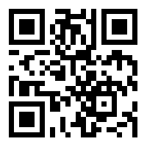
https://learn.codemithra.com

Slide 15




THANK YOU
+91 78150 95095
codemithra@ethnus.com
www.codemithra.com

